Slide 1
Intro to Cloud Computing CS4037 (BCS-6A) Lecture 01
Instructor: Danyal Farhat
Lecturer, Department of Computer Science, FAST
24 January, 2023

Slide 2
Lecture’s Agenda
Classroom Etiquettes
Grading Policy – Tentative (may be changed)
Basic Terminologies
Instructor Academic Background
Instructor Industrial Background
Administrative Information
Textbooks
Reference Books
Course Objectives
Course Outline

Slide 3
Classroom Etiquettes
Please come on time and attend class with attention, there will be questions from class discussion
Talking among each other is not appreciated, while I am teaching
Leaving the class to attend a phone call is not appreciated
Quizzes will in general be announced
They can be held at the start or end of class
Cases of plagiarism (copying of other people’s work) will lead to marks and/or grade reductions

Slide 4
Grading Policy – Tentative
Quizzes → 10%
If we have 7 or more quizzes, we will choose the best 5 or 6
Assignments → 10%
All assignments will count to your grade
Presentation / Class Participation → 5+5=10%
Midterm I and Midterm II → 30%
Final Exam → 40%
Comprehensive exam (all course contents included)

Slide 5
Basic Terminologies
Dedicated Link
A Dedicated Link or an IP Link is a dedicated network connection, meaning it is a guarantee of 100% of contracted capacity (full duplex).
Personal Computer
A personal computer (PC) is a multi-purpose microcomputer whose size, capabilities, and price make it feasible for individual use.
Server
A server is a computer program or device that provides a service to another computer program and its user, also known as the client.

Slide 6
Basic Terminologies (Cont.)
Cluster
A cluster is a collection of virtualized servers whose hardware resources are abstracted and aggregated as single resource pool.
Server Rack
The modern server rack and cabinet dimensions are of 42U size, i.e. 24 inches (2 feet) wide, and 73.6 inches (~6.2 feet) tall.
Data Center
Collection of hundreds of server racks, thousands of physical servers mounted inside server racks, and associated equipment (PMM, HVAC, switches and routers etc.)

Slide 7
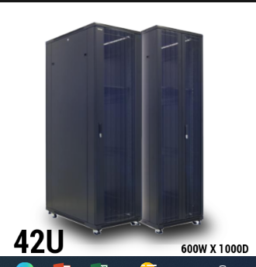
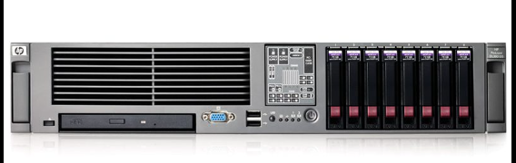
Basic Terminologies (Cont.)
HP ProLiant Server
42 U Server Rack

Slide 8
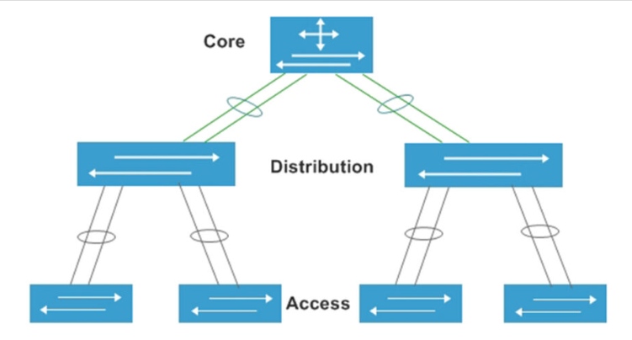
Basic Terminologies (Cont.)
Access Switch
The access switch is used to access the terminal.
Aggregation / Distribution Switch
The aggregation switch is used to aggregate the access switch.
Core Switch
The core switch is used to aggregate the aggregation switch and is also responsible for connecting to the Internet.

Slide 9
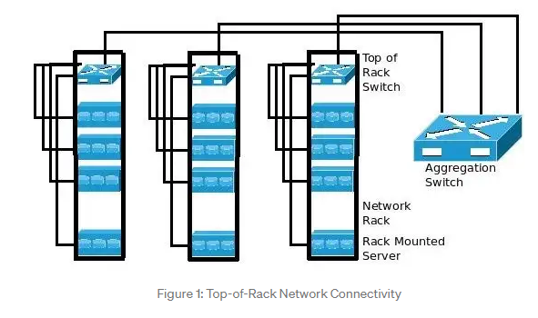
Basic Terminologies (Cont.)
Top of Rack Switching
Top-of-rack switching is a data center architecture design in which computing equipment like servers, appliances and other switches located within the same or adjacent rack are connected to an in-rack network switch.

Slide 10
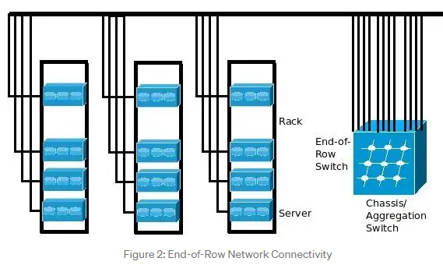
Basic Terminologies (Cont.)
End of Row Switching
In the end of row design, each server in individual racks is required to connect with a common aggregation switch directly, without connecting to individual switches in each rack.

Slide 11
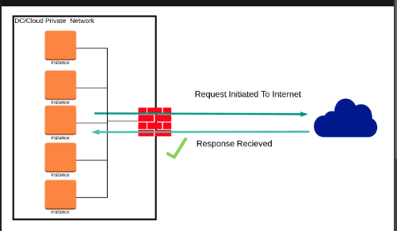
Basic Terminologies (Cont.)
Egress Traffic
Egress in the world of networking implies traffic that exits an entity or a network boundary.
Ingress Traffic
Ingress is traffic that enters the boundary of a network.
Outbound Traffic
Outbound traffic originates inside the network.
Inbound Traffic
Inbound traffic originates from outside the network.
Notes:
Are Egress and Outbound traffic same?

Slide 12
Basic Terminologies (Cont.)
Virtualization
Virtualization is the creation of a virtual - rather than actual - version of something, such as an operating system (OS), a server, a storage device or network resources.
Virtualization uses software that simulates hardware functionality to create a virtual system.
VMware Workstation, Oracle VM Virtual Box, VMware Fusion.
Cloud Computing
Collection of virtualized server in the form of single cluster or many clusters.
Cloud computing is the on-demand availability of computer system resources, especially data storage and computing power, without direct active management by the user.
Large clouds often have functions distributed over multiple locations, each of which is a data center.
VMware vSphere, Microsoft Azure, Amazon Web Services,

Slide 13
Basic Terminologies (Cont.)
Parallel Computing
Parallel computing is a type of computation in which many calculations or processes are carried out simultaneously.
Large problems can often be divided into smaller ones, which can then be solved at the same time.
Distributed Computing
A distributed system is a system whose components are located on different networked computers, which communicate and coordinate their actions by passing messages to one another from any system.
Distributed computing is a field of computer science that studies distributed systems.

Slide 14
Instructor Academic Background
BSCS, FAST NUCES ISB
FYP: AWD ANALYZER [Implemented in Python and ASP.NET]
The web interface that provided analytical feedback based on user reviews and product’s specifications. It scraped reviews data from different websites (under legal constraints) and provided feedback using sentiment analysis by implementing bag of words and random forests algorithms.
MSCS, UCP LHR
Thesis: Cyber Risk Modelling for Ransomware Attacks in Business Sectors [Implemented in R]
It propose and implement a generalized mathematical model (consisting of parameters, mathematical equations and Monte Carlo simulation) for cyber risk estimation of ransomware attacks on personal computers of different organization categories (micro, small, medium, large, and giant) and for different industrial sectors (information technology, finance, retails and other).

Slide 15
Instructor Academic Background
Publication
D. Farhat and M.S. Awan, "A Brief Survey on Ransomware with the Perspective of Internet Security Threat Reports," IEEE Xplore, 9th International Symposium on Digital Forensics and Security (ISDFS), 28-29 Jun, 2021
Link: https://ieeexplore.ieee.org/document/9486348

Slide 16
Instructor Industrial Background
Management Trainee, PTCL
Worked on a project to identify company’s grey areas and to suggest strategies to remove or lesson those areas.
Worked in traffic shaping implementation using pipes in Free BSD OS, provide presentations on CRM of call centers, carrier and wholesale services, digital services, and after sales services.
Assistant Manager Network Support – Data Center Operations, PTCL
Worked in TIA-942 certified Tier-3 co-location data center on Schneider Electric infrastructure and on Juniper networks.
Provide assistance in managing the Shell part of Data Center which includes BMS monitoring, Access Control systems, Heating, Ventilation, and Air Conditioning (HVAC) system, Very Early Smoke Detection Apparatus (VESDA) system, and Power Management Module (PMM) for data centers.
Involved in the HP ProLiant servers configurations during cloud infrastructure deployment.

Slide 17
Instructor Industrial Background
Assistant Manager Network Support – Cloud Operations, PTCL
Public Cloud management on platforms like VMware vSphere (vCloud Director, vCenter, and vRealize Operations), Microsoft Azure Stack and Microsoft Hyper-V.
Interact with stakeholders (tenants, data center, transmission, network, and business teams) to ensure coordinated operations management of cloud services and to provide technical details relating to cloud services platforms and their comparisons as per clients’ services requirements.
Supervise process of configuration management, patch management and vulnerability assessment across cloud infrastructure to ensure security, governance, and compliance objectives of the department.
Ensure process improvement, documentation and audit activities related to different certifications i.e. PCI DSS, and ISO, for cloud and NOC functions, catering both current and future needs.
Notes:
The Payment Card Industry Data Security Standard is an information security standard used to handle credit cards from major card brands.

Slide 18
Instructor Industrial Background
Cloud Specialist – JAZZ Garaj Cloud Services, Multilynx
Worked as cloud specialist in Multilynx cloud support on Jazz’s Garaj cloud services project.
Public cloud management on VMware vSphere (vCloud Director 10.2, vCenter 7, vRealize Operations 8.2, and NSX-T 3.0).
Providing managed services (like Windows, Linux, Ubuntu, and RedHat OS level support along with web-hosting and database server configurations) to cloud tenants.
Interactions with internal teams to ensure UTM enablement, IP Sec VPN, Point to Site VPN, Site to Site VPN, MPLS, and SIP connectivity for cloud tenants.
Notes:
Unified threat management is an approach to information security where a single hardware or software installation provides multiple security functions. To stop malware.
IPsec is a protocol suite for encrypting network communications.
A Point-to-Site (P2S) VPN gateway connection lets you create a secure connection to your virtual network from an individual client computer.
A site-to-site virtual private network (VPN) is a connection between two or more networks, such as a corporate network and a branch office network.
Multiprotocol Label Switching (MPLS) is a protocol-agnostic routing technique designed to speed up and shape traffic flows across enterprise wide area and service provider networks.
MPLS allows most data packets to be forwarded at Layer 2 -- the switching level -- of the Open Systems Interconnection (OSI) model, rather than having to be passed up to Layer 3 -- the routing level. For this reason, it is often informally described as operating at Layer 2.5
The Session Initiation Protocol (SIP) is a signaling protocol used for initiating, maintaining, and terminating communication sessions that include voice calls, video conferencing, instant messaging, and media distribution.

Slide 19
Instructor Industrial Background
Cloud Specialist – JAZZ Garaj Cloud Services, Multilynx
Providing managed services related to security like Endpoint Detection and Response (EDR), Vulnerabilities Assessment using Qualys Agent, and Linux Security Information and Event Management (SIEM) configurations for SOC team to ensure cloud infrastructure security.
Public cloud management logs tracking using Jira for smooth operations of cloud services.
Notes:
Endpoint detection and response (EDR) is an integrated endpoint security solution that combines real-time continuous monitoring and collection of endpoint threat data with rules-based automated response and analysis capabilities.
Security information and event management is a field within the field of computer security, where software products and services combine security information management and security event management. They provide real-time analysis of security alerts generated by applications and network hardware.
Jira is a proprietary issue tracking product developed by Atlassian that allows bug tracking and agile project management.

Slide 20
Administrative Information
Office: To be announce
Email:
danyal.farhat@nu.edu.pk
danyal.farhat@lhr.nu.edu.pk
Office Hours: To be announce
Website:
Classroom Code 6A: uukjblg

Slide 21
Textbooks
Student Handbook of the AWS Cloud Foundation Course.
Distributed and Cloud Computing by Kai Huwang, Geoffrey C. Fox and Jack J. Dongarra
Cloud computing Concepts, Technology and Architecture by Thomas Erl
Architecting the cloud by Michael J. Kavis

Slide 22
Reference Books
Cloud Computing: Principles and Paradigms by Buyya R.
Modern Operating Systems by Andrew S. Tanenbaum 4th edition
Mastering Cloud Computing by Buyya R.

Slide 23
Course Objectives
Demonstrate familiarity with the need and significance of cloud computing
Demonstrate familiarity with cloud service and deployment models
Demonstrate familiarity with virtualization, the Internet and other technologies enabling cloud computing
Demonstrate an understanding of the data center architecture
Use cloud computing in software development and/or take up research in cloud computing

Slide 24
Course Outline
Module 1: Cloud Concepts Overview
Define different types of cloud computing models
Describe six advantages of cloud computing
Recognize the main AWS service categories and core services
Review the AWS Cloud Adoption Framework (AWS CAF)
Module 2 - Cloud Economics and Billing
AWS TCO Calculator
AWS Simple Monthly Calculator
AWS Organizations
AWS Billing Dashboard

Slide 25
Course Outline (Cont.)
Module 3: AWS Global Infrastructure Overview
Identify the difference between AWS Regions, Availability Zones, and edge locations
Identify AWS services and service categories
Module 4: AWS Cloud Security
Recognize the shared responsibility model
Identify the responsibility of the customer and AWS
Recognize IAM users, groups, and roles
Describe different types of security credentials in IAM
Identify the steps to securing a new AWS account
Explore IAM users and groups
Recognize how to secure AWS data
Recognize AWS compliance programs

Slide 26
Course Outline (Cont.)
Module 5: Networking and Content Delivery
Recognize the basics of networking
Describe virtual networking in the cloud with Amazon VPC
Label a network diagram
Design a basic VPC architecture
Indicate the steps to build a VPC
Identify security groups
Create their own VPC and add additional components to it to produce a customized network
Identify the fundamentals of Amazon Route 53
Recognize the benefits of Amazon CloudFront

Slide 27
Course Outline (Cont.)
Module 6: Compute
Provide an overview of different AWS compute services in the cloud
Demonstrate why to use Amazon Elastic Compute Cloud (Amazon EC2)
Identify the functionality in the Amazon EC2 console
Perform basic functions in Amazon EC2 to build a virtual computing environment
Identify Amazon EC2 cost-optimizationelements
Demonstrate when to use AWS Elastic Beanstalk
Demonstrate when to use AWS Lambda
Identify how to run containerized applications in a cluster of managed servers

Slide 28
Course Outline (Cont.)
Module 7: Storage
Identify the different types of storage
Explain Amazon Simple Storage Service (Amazon S3)
Identify the functionality in Amazon S3
Explain Amazon Elastic Block Store (Amazon EBS)
Identify the functionality in Amazon EBS
Perform functions in Amazon EBS to build an EC2 storage solution
Explain Amazon Elastic File System (Amazon EFS)
Identify the functionality in Amazon EFS
Explain Amazon Simple Storage Service Glacier
Identify the functionality in Amazon S3 Glacier
Differentiate between Amazon EBS, Amazon S3, Amazon EFS, and Amazon S3 Glacier

Slide 29
Course Outline (Cont.)
Module 8: Databases
Explain Amazon Relational Database Service (Amazon RDS)
Identify the functionality in Amazon RDS
Explain Amazon DynamoDB
Identify the functionality in Amazon DynamoDB
Explain Amazon Redshift
Explain Amazon Aurora
Perform tasks in an Amazon RDS database such as launching, configuring, and interacting

Slide 30
Course Outline (Cont.)
Module 9: Cloud Architecture
Describe the AWS Well-Architected Framework, including the five pillars
Identify the design principles of the AWS Well-Architected Framework
Explain the importance of reliability and high availability
Identify how AWS Trusted Advisor helps customers
Interpret AWS Trusted Advisor recommendations

Slide 31
Course Outline (Cont.)
Module 10: Automatic Scaling and Monitoring
Indicate how to distribute traffic across Amazon EC2 instances by using Elastic Load Balancing
Identify how Amazon CloudWatch enables you to monitor AWS resources and applications in real time
Explain how Amazon EC2 Auto Scaling launches and releases servers in response to workload changes
Perform scaling and load balancing tasks to improve an architecture

Slide 32
Thank You
Notes:
Thanks for participating!

